Slide 1

PREDICT 453 Text Analytics: Cohort 9: Assessing Clustering Results Northwestern University SPS Master of Science in Predictive Analytics
u

Slide 2
Purpose
Establish a new hierarchical relationship which explains the ontology of DSIs in current cohorts
Compare the ontology in previous and current cohort to find out how to improve the clustering
Interpret the underlying information enriched in the entire corpus
Provide an unambiguous version of cohort for future work

Slide 3
Method
DSI collecting for cohort 9
Term searching
RTV initiating
EC (equivalence classes) generating
Matrix forming
Cluster analysis and interpretation

Slide 4
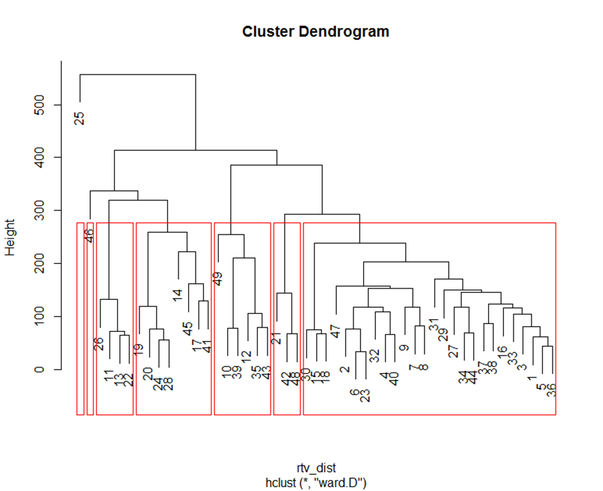
First Round RTV
* 7 Clusters from the first round

Slide 5
First Round RTV

Slide 6
First Round RTV

Slide 7
Expected Cluster: Discussion 7
Cluster1: Domestic Affair/Policy/ Healthcare
DSI: 1, 3, 4, 5,9,10,12,17,18,25,29,30,32,33,34,35,36,39,43,44,49
Cluster2: Foreign Affair/Policy
DSI: 8,11,15,27,31,37,38,42, 46,47,48
Cluster3: Energy/Climate Change
DSI: 19,20,21,24,28,41
Cluster4: Other. (This cluster is mostly related to Trump's personal issues/points of view)
DSI: 6, 14,16,23,40
Cluster5: Russia
DSI: 13,22,26,
Cluster6: Economics Issues
DSI: 7,45

Slide 8
Expected Cluster: Discussion 7
Based on Discussion 7: Estimate Likely Clusters, there are 6 clusters. The biggest cluster is Cluster 1 with Domestic Affair/Policy/Health. It includes 21 DSIs which is close to half of the total 49 DSIs.
Cluster 2 is the second largest cluster regarding Foreign Affair/Policy with 12 DSIs included.
Cluster 3 is about Energy/Climate Change. It contains 6 DSIs. This cluster mostly talks about the Paris agreement.
Cluster 4 includes Donald Trump’s personal issues/point of view on different issues. DSI 6 talks about Trump will dissolve his foundation to avoid conflict of interest; DSI 14 talks about Trump’s conflict interest after becoming president.
Cluster 5 is associated with Russia-related issues, which only contains 3 DSIs.
Cluster 6 is the last one with 2 DSIs and focuses on the economy.

Slide 9
Expected Cluster: Second Round RTV
Cluster1: Domestic Affair
Cluster2: Foreign Affair
Cluster3: Business
Cluster4: Economy
Cluster5: Healthcare
Cluster6: Environment
Cluster7: Other

Slide 10
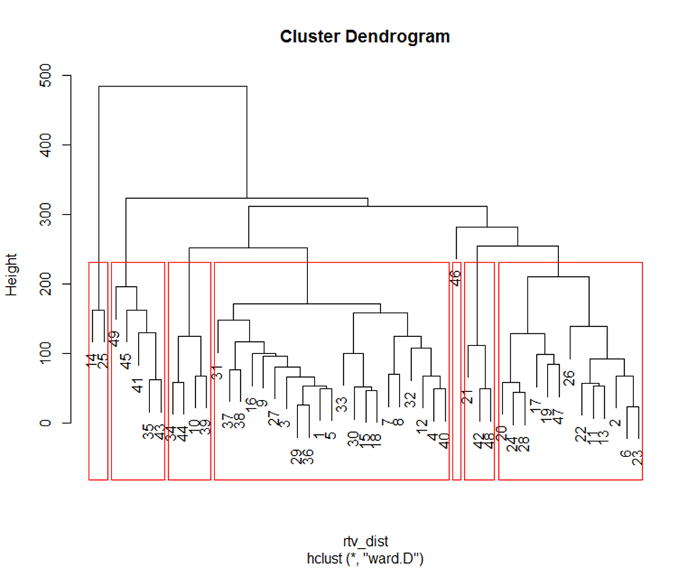
Second Round- Cluster Results

Slide 11
Second Round Clusters
Cluster1 – Domestic policy and Business issues
Cluster2 – Health care
Cluster3 – Russia scandal
Cluster4 – Energy and Environmental policy
Cluster5 – Foreign diplomacy
Cluster6 – Health care/Economics
Cluster7 – Immigration/Travel ban
Expected Cluster: Second Round RTV
Cluster1: Domestic Affair
Cluster2: Foreign Affair
Cluster3: Business
Cluster4: Economy
Cluster5: Healthcare
Cluster6: Environment
Cluster7: Other

Slide 12
K Means Approach
Uses RTV and Term matrix to create k means clusters
Use of Elbow plot to pick number of clusters
Cluster plot to view which DSI’s overlap

Slide 13
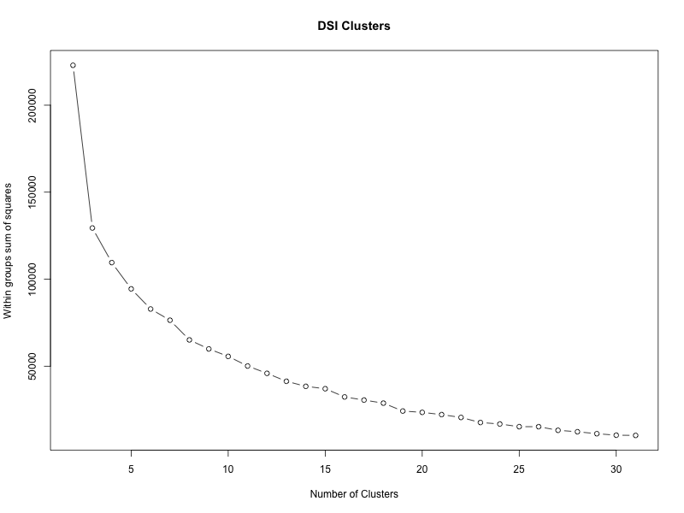
Elbow plot
‘elbow rule’ indicates 4 clusters.
HC selected 7 clusters
More than 7 would tend to overfit

Slide 14
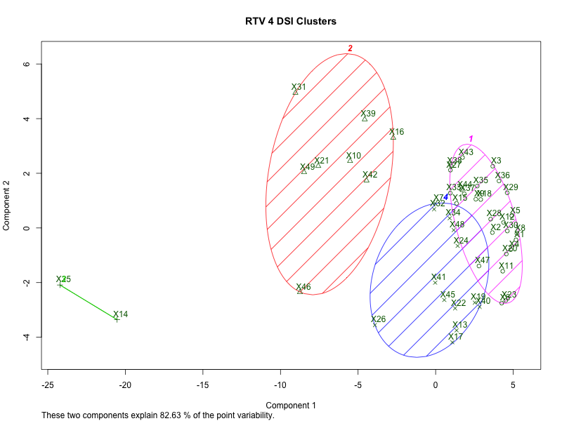
Cluster Plot w 4 Clusters
Elbow plot approach has nice cluster plot, but rather vague results.

Slide 15
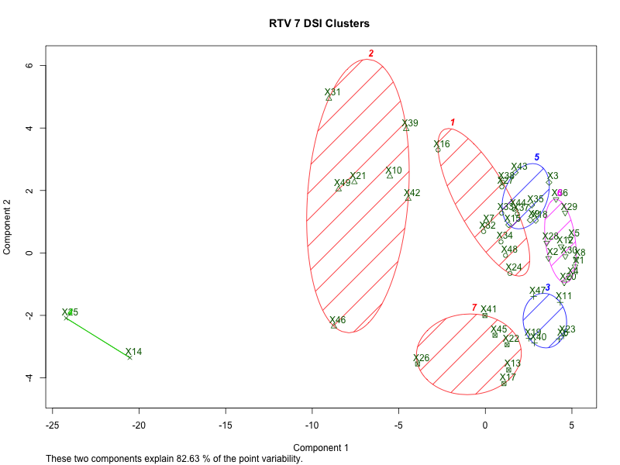
Cluster Plot w 7 Clusters
K means clusters with many clusters, can result in different clusters results*
The below can be used to understand distance between DSI’s
Labels are subjective and are for reference use in creation of RTV’s
Domestic Affairs
China
Foreign Affairs
Business / Regulation
Other
Russia
* HC clust selected slightly different clusters vs k means.

Slide 16
Expected Cluster: Discussion 7
Cluster1: Domestic Affair/Policy/ Healthcare
DSI: 1, 3, 4, 5,9,10,12,17,18,25,29,30,32,33,34,35,36,39,43,44,49
Cluster2: Foreign Affair/Policy
DSI: 8,11,15,27,31,37,38,42, 46,47,48
Cluster3: Energy/Climate Change
DSI: 19,20,21,24,28,41
Cluster4: Other. (This cluster is mostly related to Trump's personal issues/points of view)
DSI: 6, 14,16,23,40
Cluster5: Russia
DSI: 13,22,26,
Cluster6: Economics Issues
DSI: 7,45

Slide 17
Expected Cluster: Second Round RTV
Cluster1: Domestic Affair
Cluster2: Foreign Affair
Cluster3: Business
Cluster4: Economy
Cluster5: Healthcare
Cluster6: Environment
Cluster7: Other

Slide 18
Second Round- Cluster 1

Slide 19
Second Round- Cluster 1

Slide 20
Second Round- Cluster 2

Slide 21
Second Round- Cluster 2

Slide 22
Second Round- Cluster 3

Slide 23
Second Round- Cluster 4

Slide 24
Second Round- Cluster 5

Slide 25
Second Round- Cluster 6

Slide 26
Second Round- Cluster 7

Slide 27
Analysis
The clustering result from cohort8 contains ambiguous information. Each cluster seems quite random not topic-related; the RTV list has many duplicates.
Current clustering result are more closer to the expected one, comparing to previous clustering based on 1st round RTV.
5 clusters make more sense in this case since the expected cluster 5 (Russia) could be included in cluster 2 (Foreign Affairs).
Some DSIs are not expected, which may get improved by removing some popular ECs, like ‘president’.
Overall the analytics provide us the relationship between these terms with information contained in these topics
One of the limitation is that only 9 new DSIs were added on to 40 old ones, which may not influence the ontology a lot.

